Slide 1
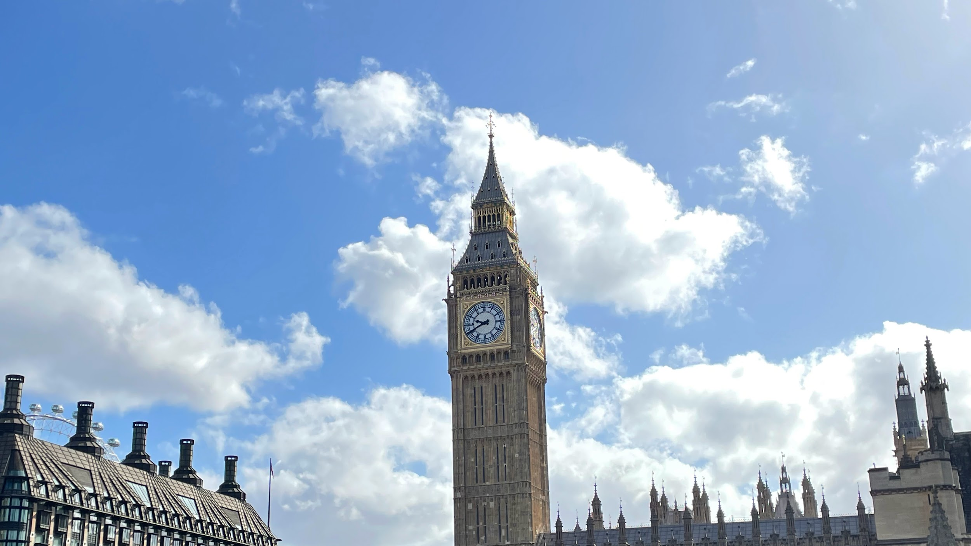
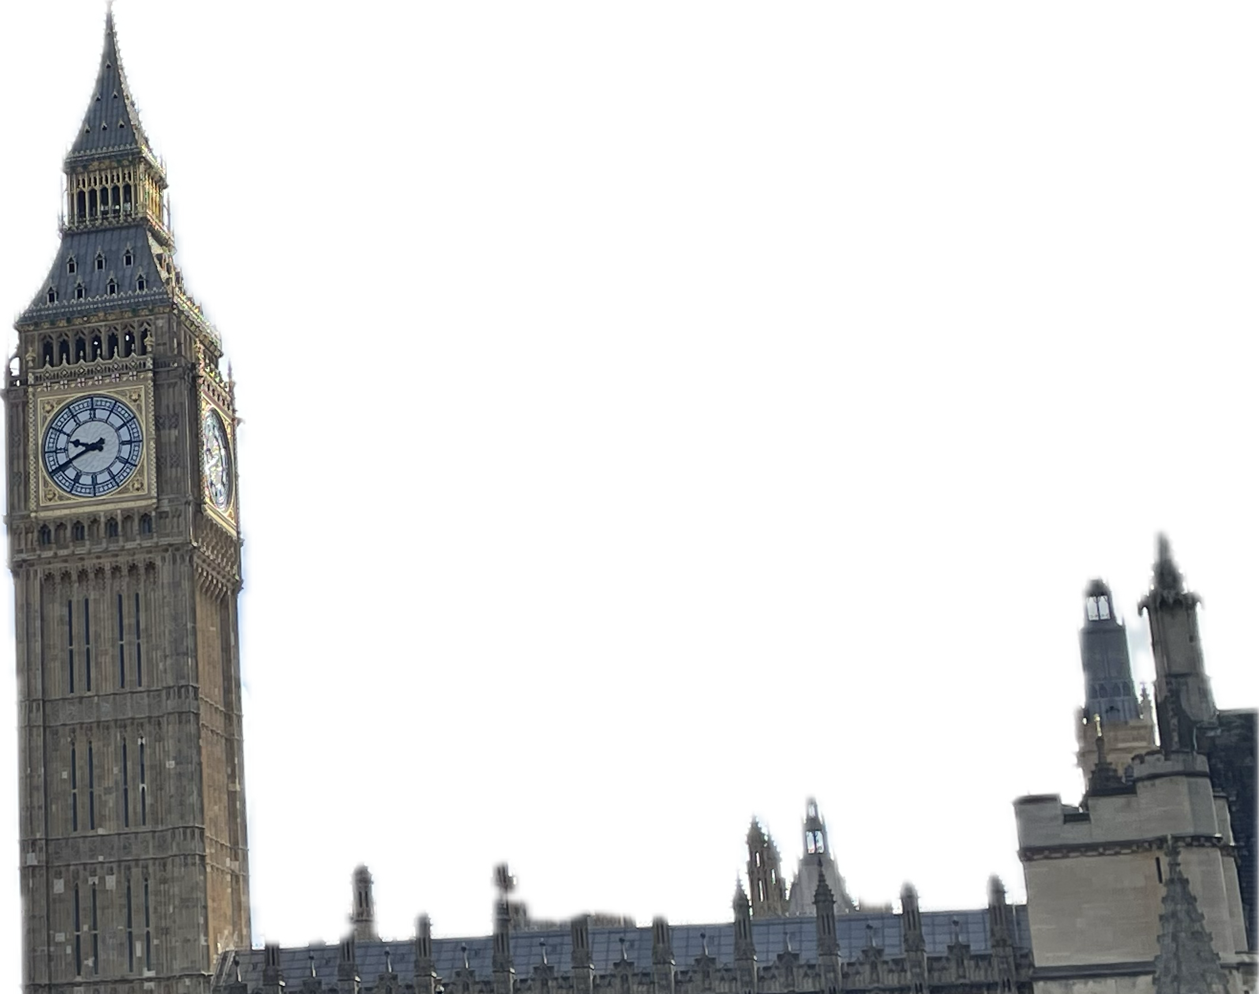
Trip to
London
_{Adam Houžvička}

Slide 2
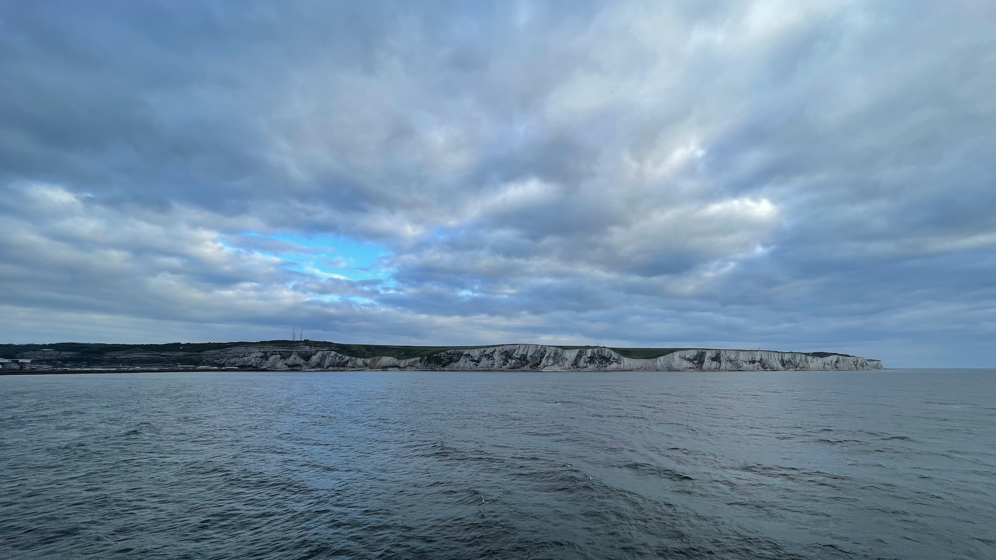
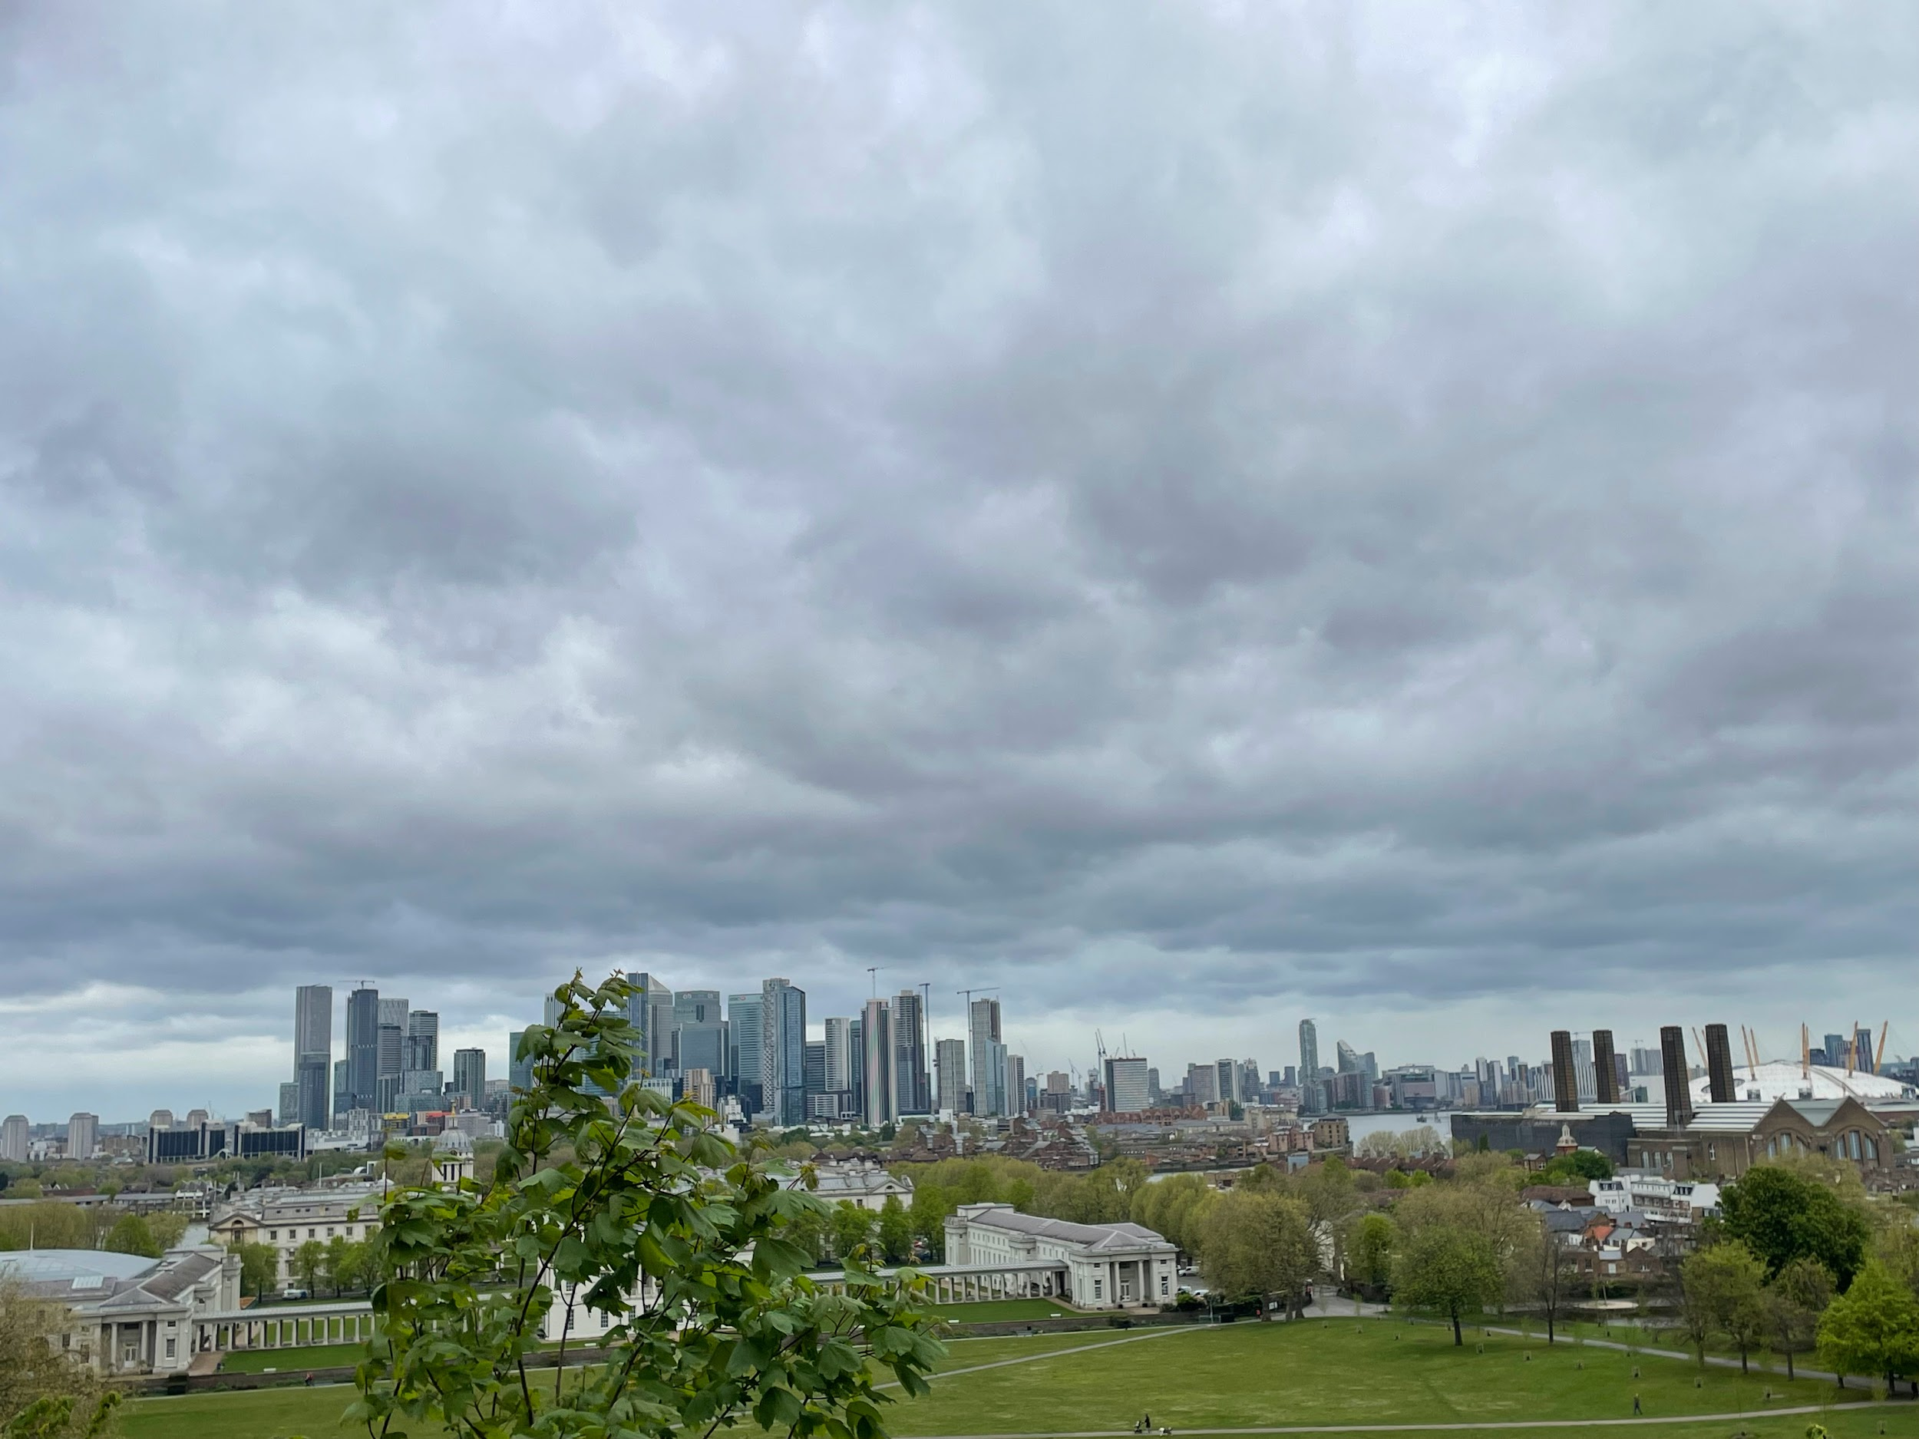
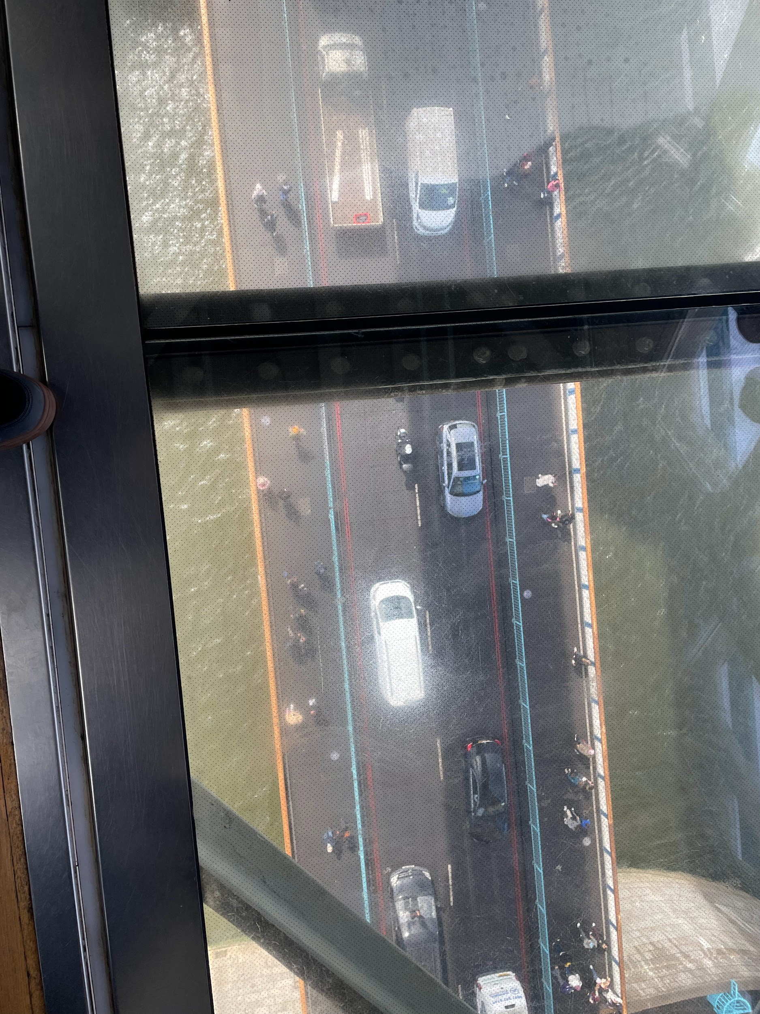
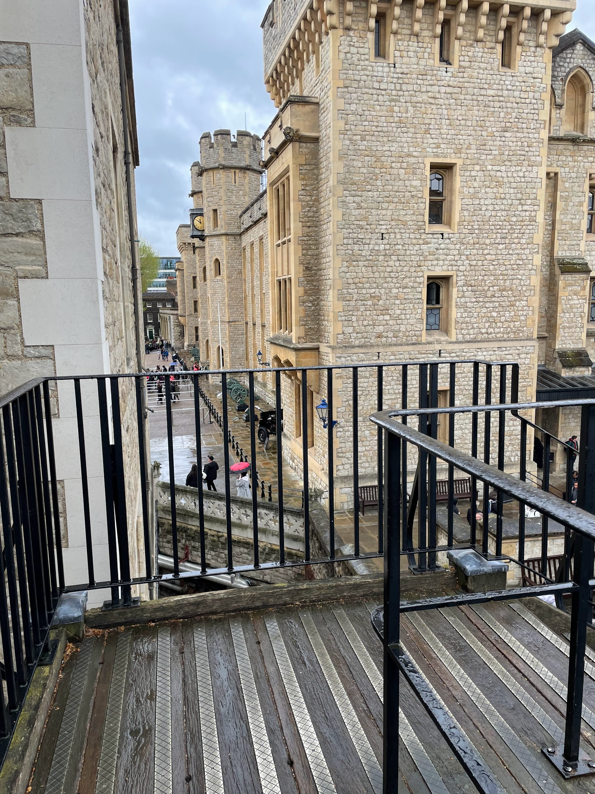
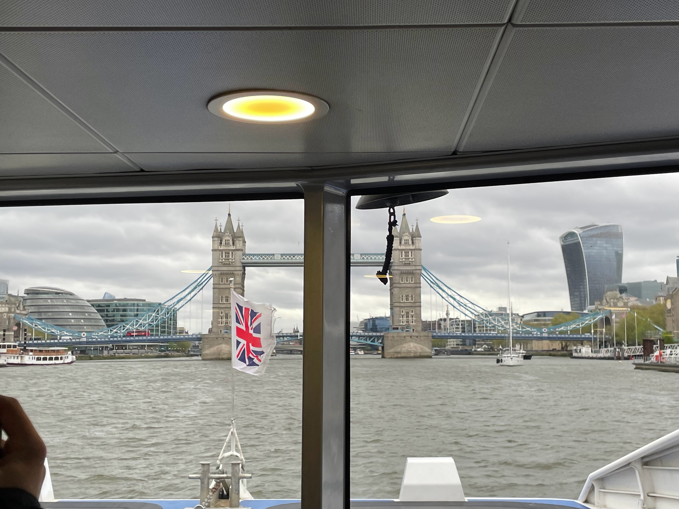
1st Day
On the first day we went for a walk in Greenwich park.
Then we took a boat on the Thames to visit the Tower of London.
After that we went to cross Tower Bridge with a visit to the towers and a walk on the glass floor.
In the evening we took the subway to the O2 arena and then in the evening we were accommodated in families.

Slide 3
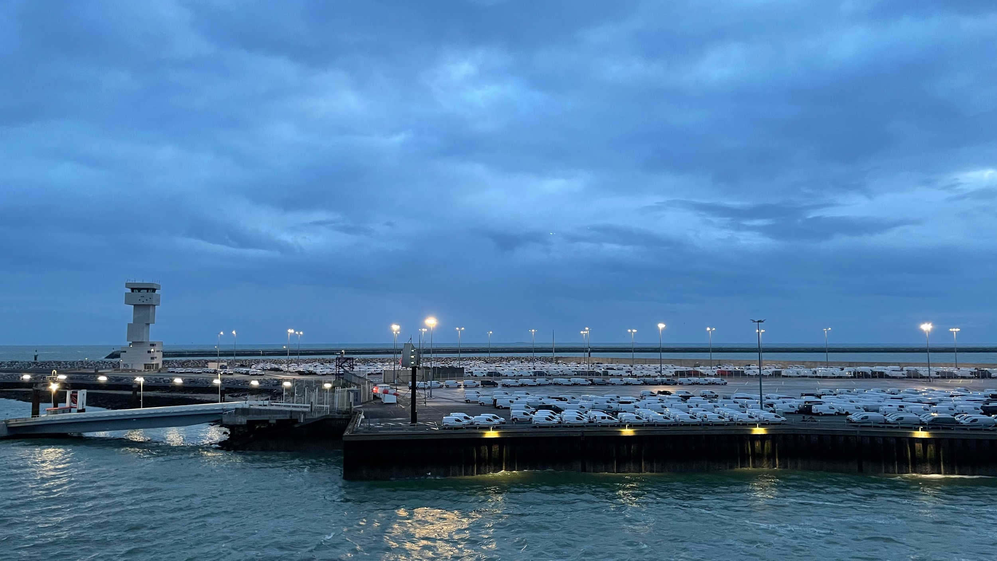
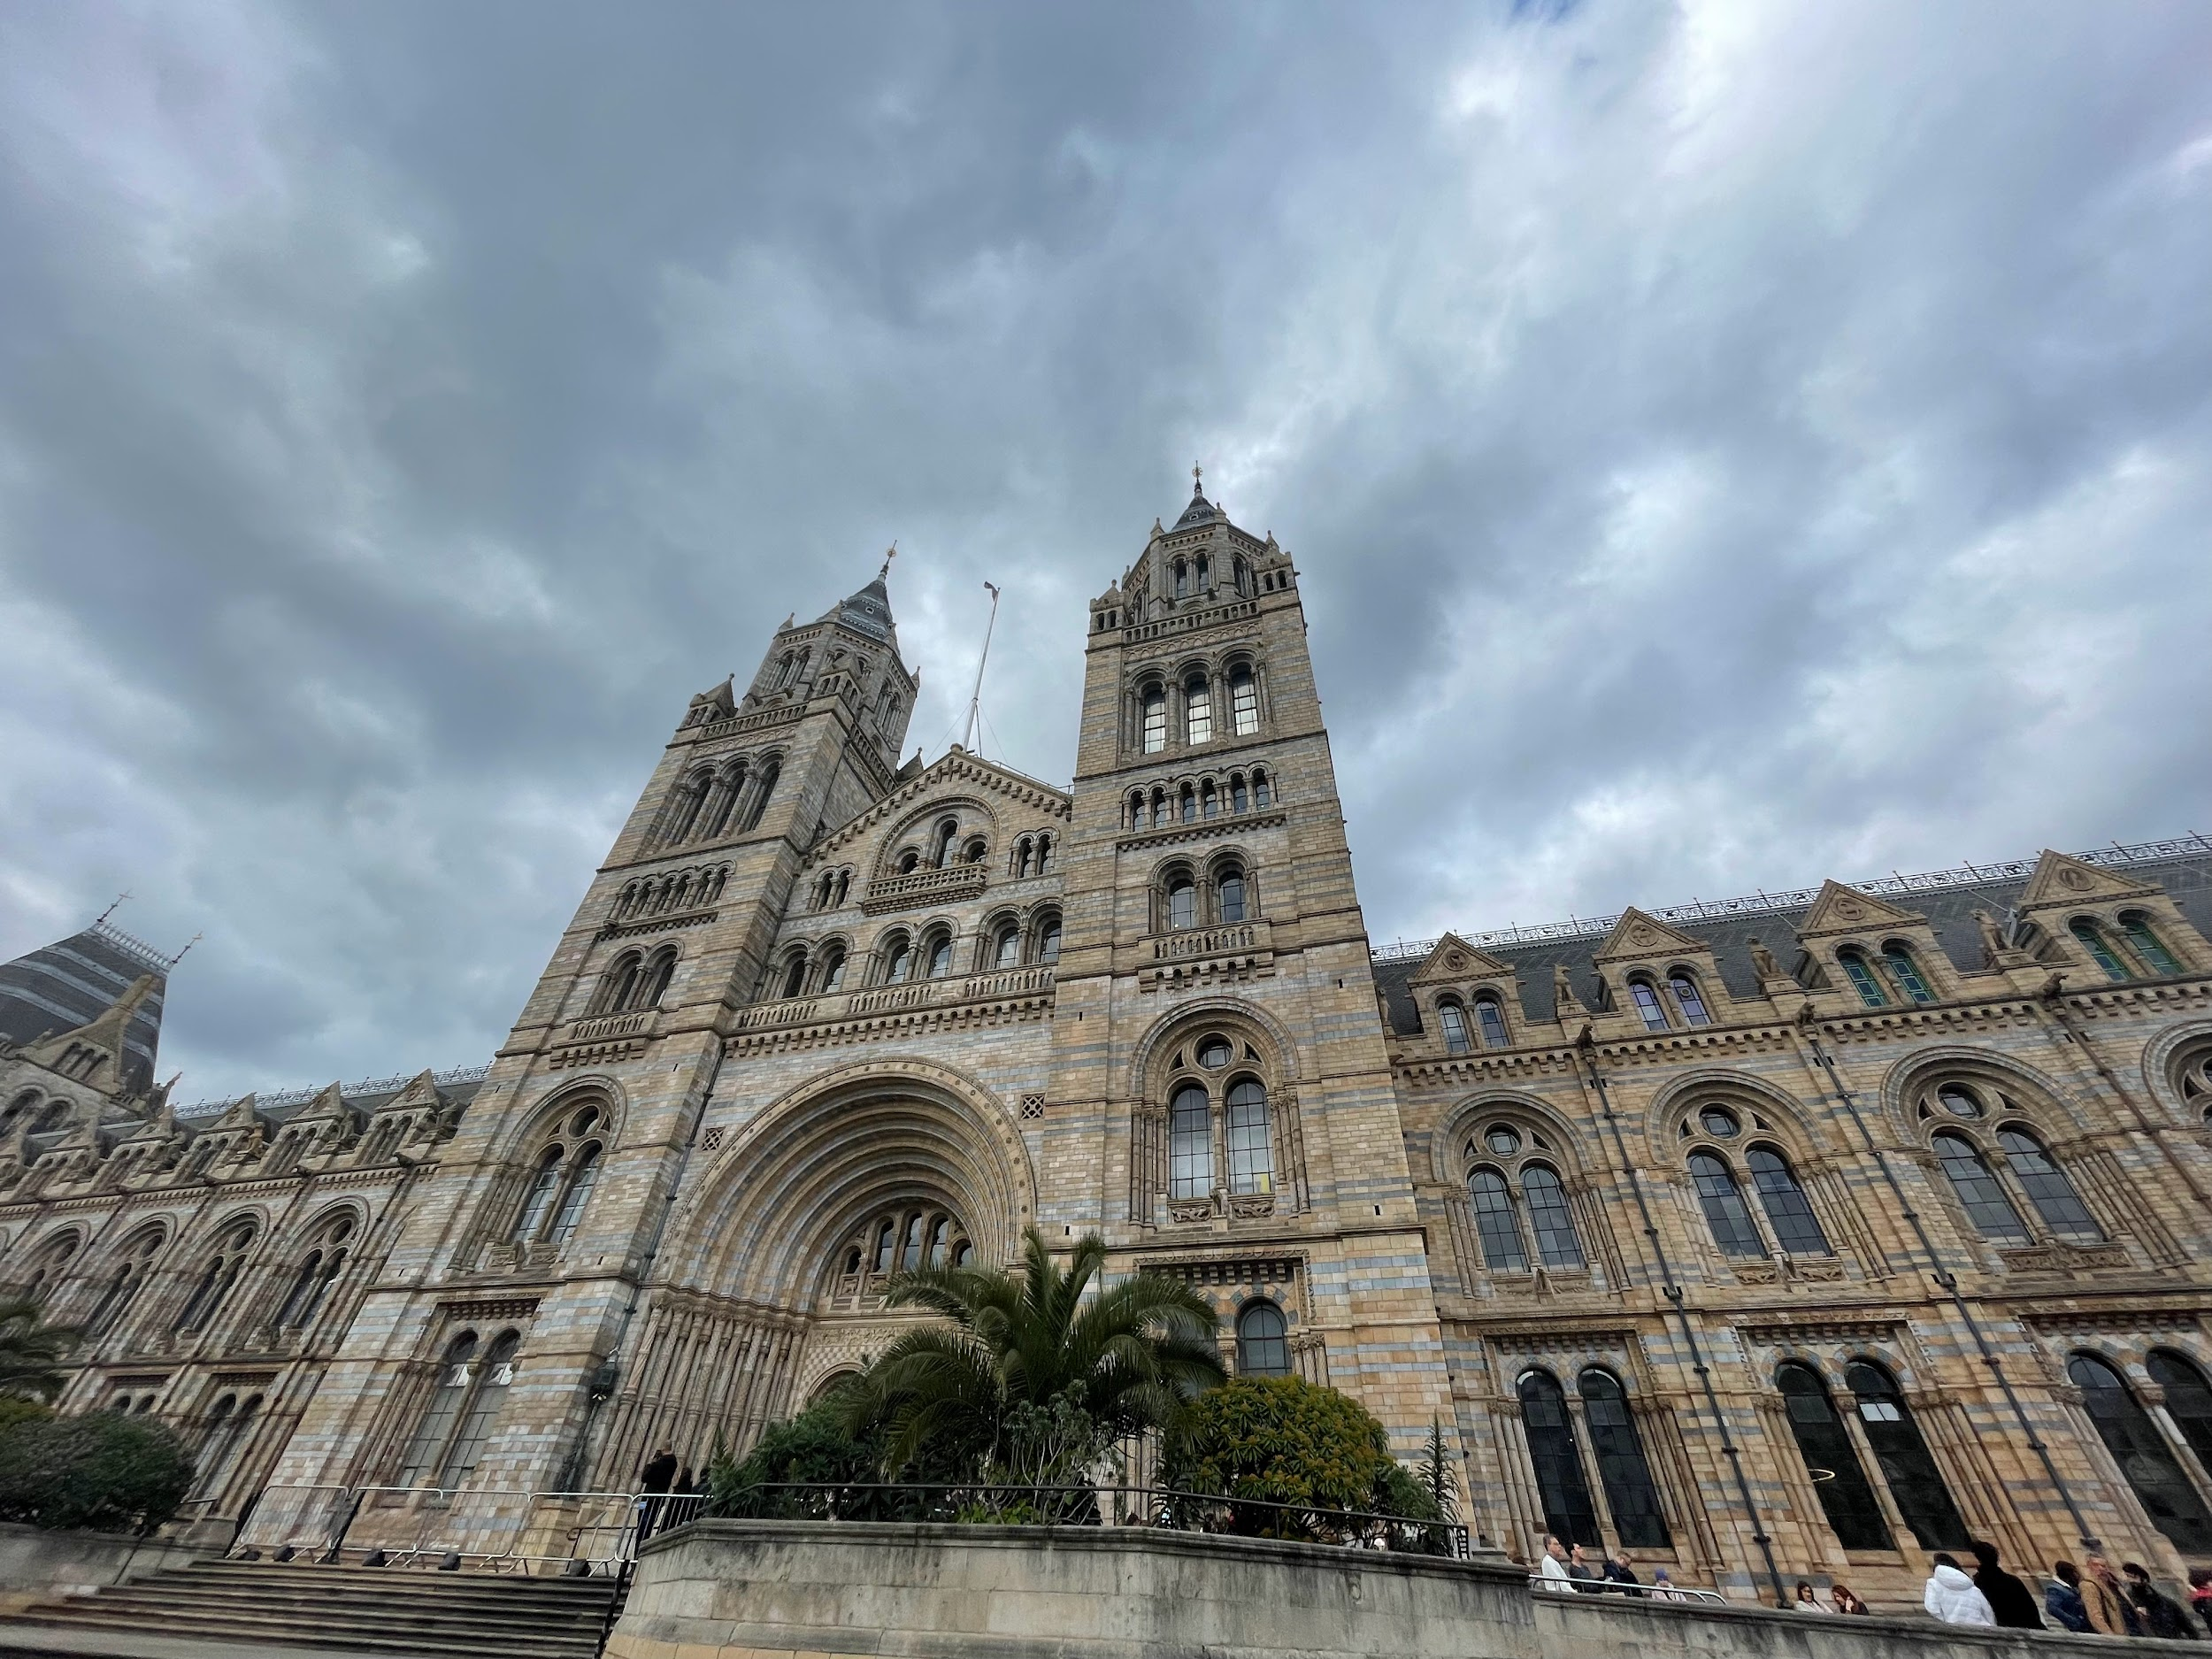
2nd Day
On the second day we were on a full day trip to Windsor and London.
- In the morning we were on a tour of the royal city of Windsor.
- In the afternoon we visited the Natural history Museum.
In the evening we returned to the families.

Slide 4
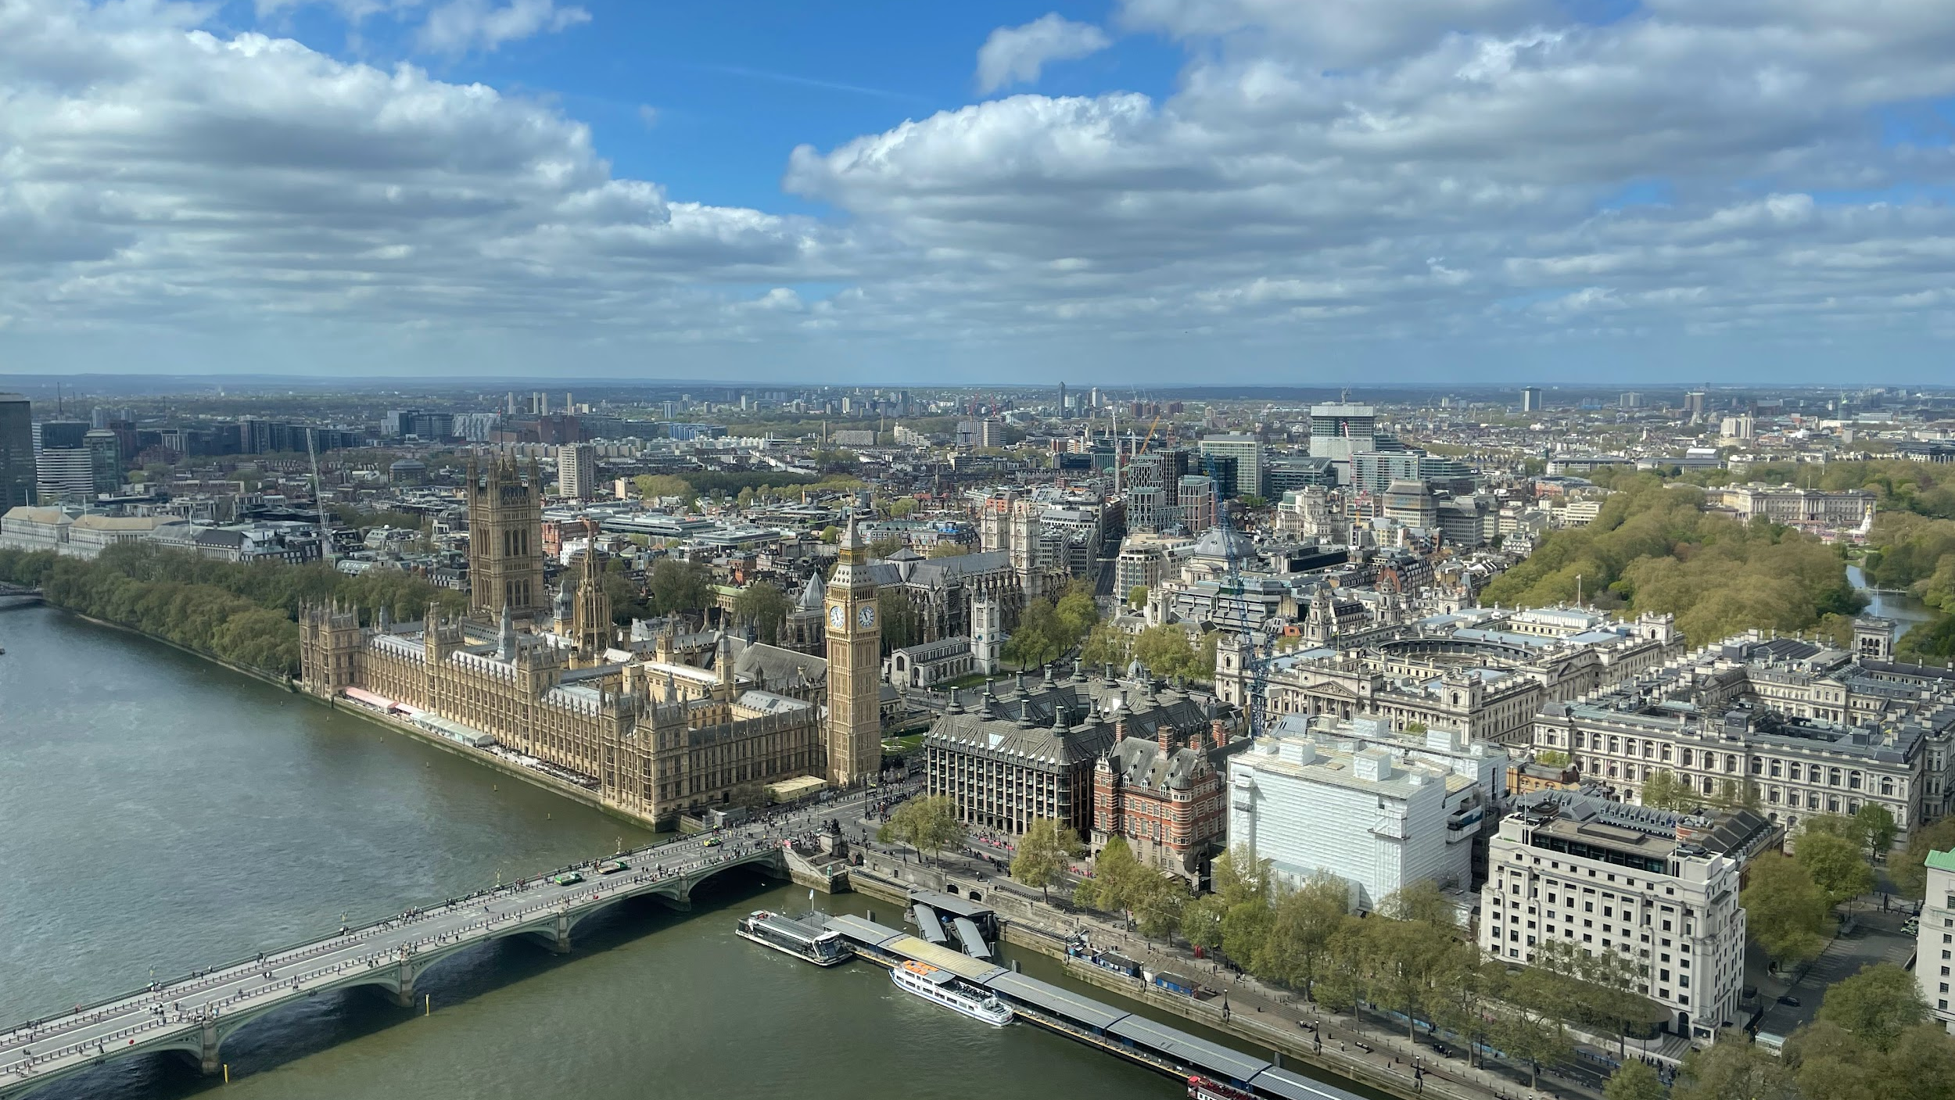
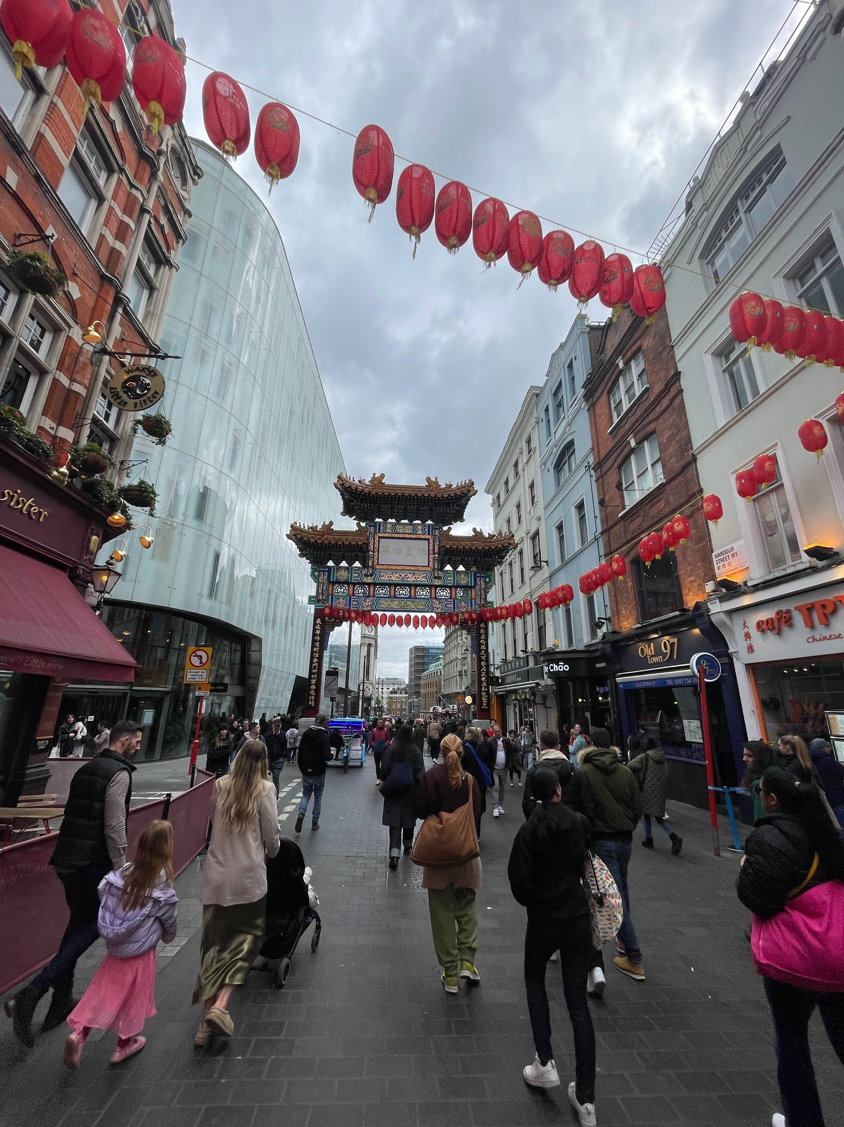
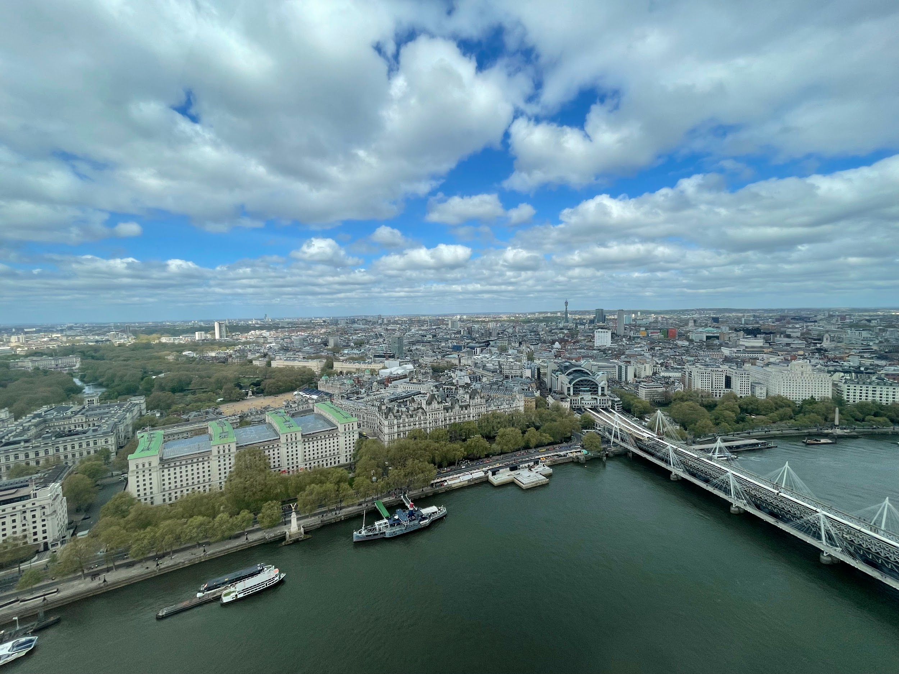
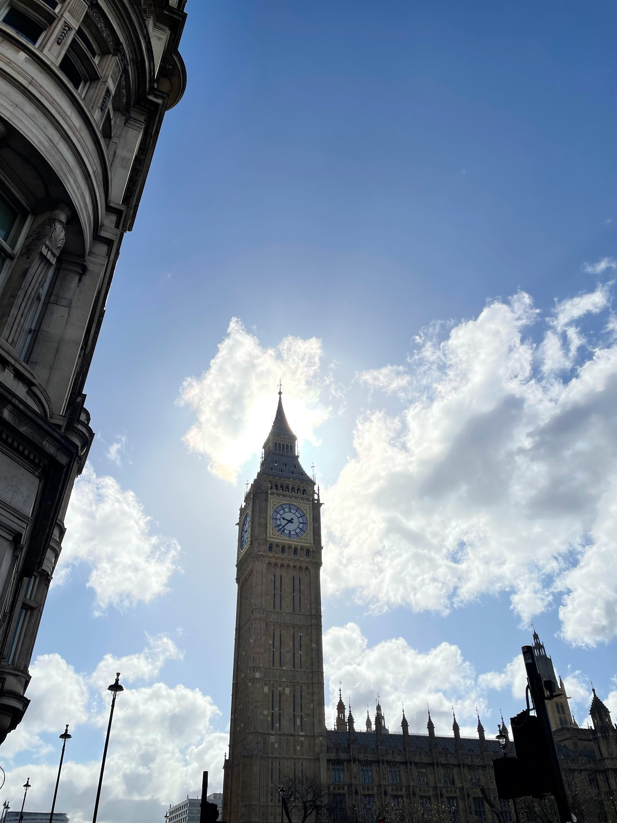
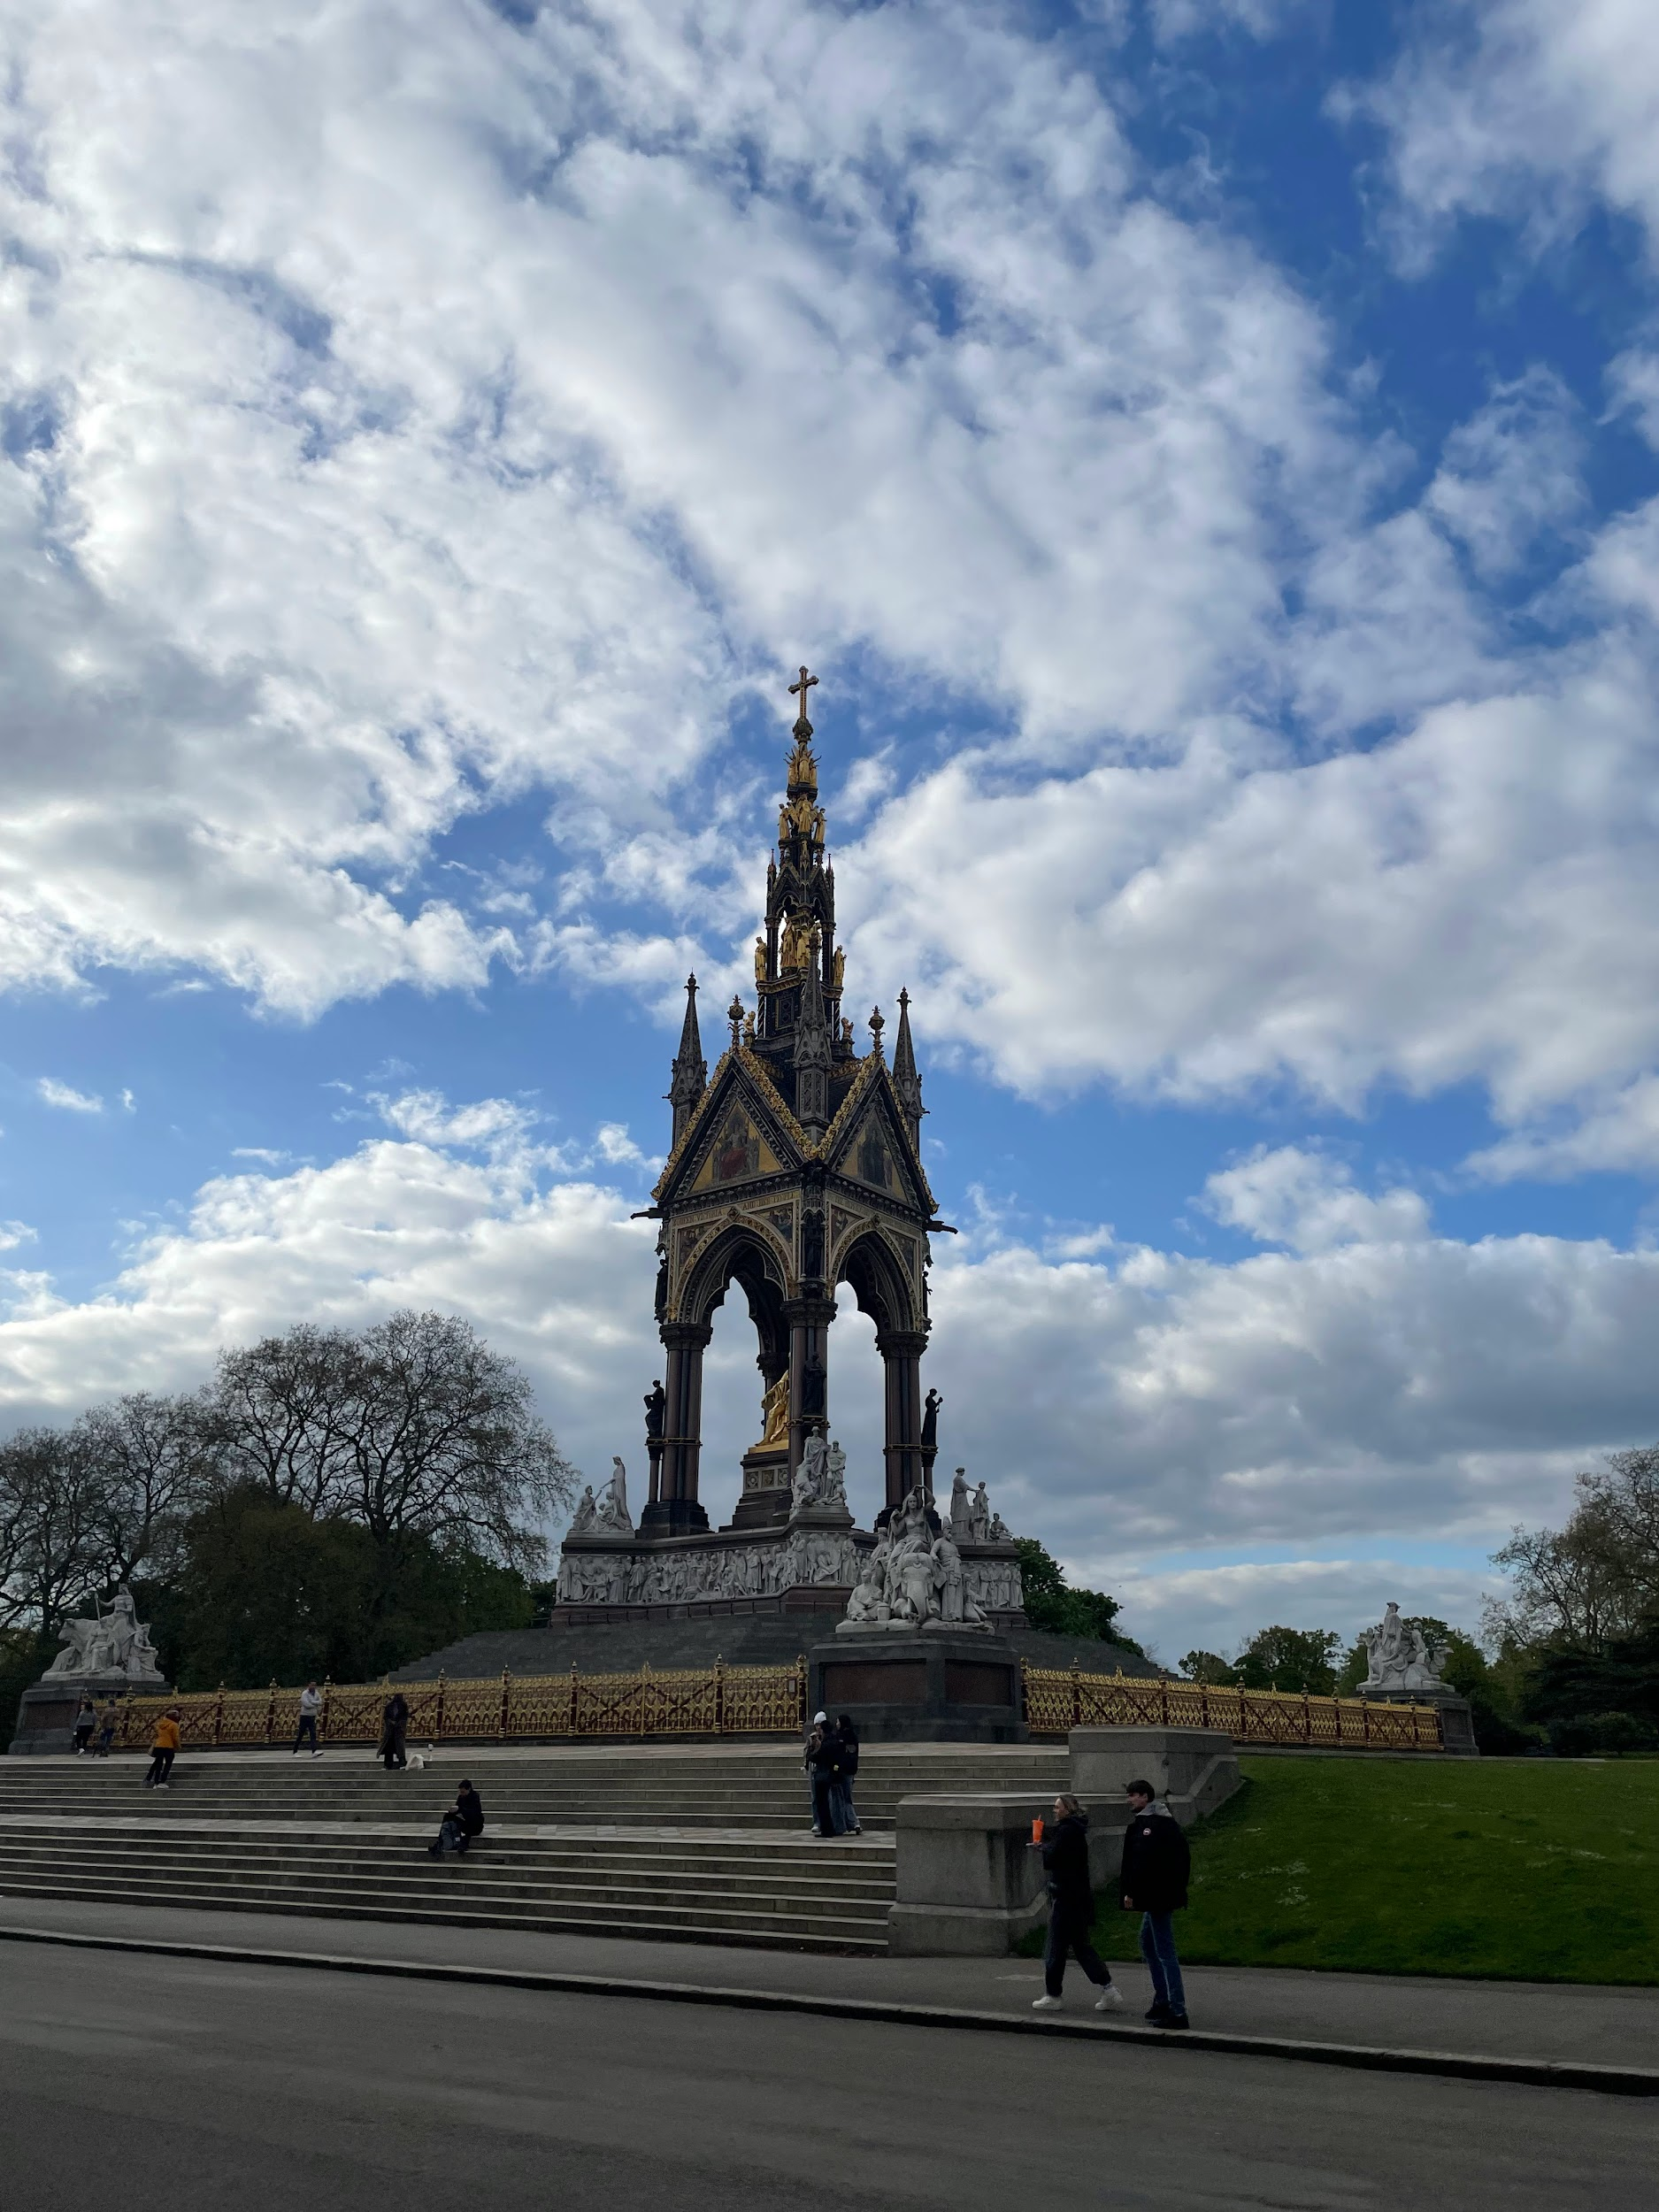
3rd Day
On the third day we were on a walking tour.
- We saw Big Ben, Westminster Abbey, China Town, Leicester Square…
We were also at the London eye.
then we took the subway to the O2 arena and then went back to the Czech Republic.

